Slide 1
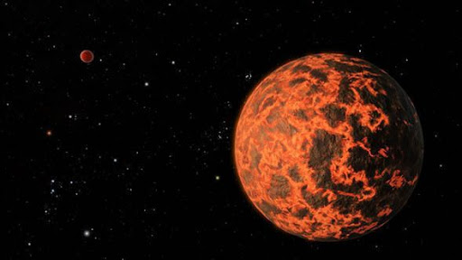
Planet Gliese
A mysterious planet beyond our galaxy and all, an unidentified, unknown planet until now by scientific research.

Slide 2
How big is Gliese?
Well, the size of this planet is 12,500 Miles from the top to the Centre of the planet And the distance of the equator all around is 35,625 miles estimated. That is bigger than the size of earth by 4574 miles from the Centre to the top and 10724 miles all around the equator.

Slide 3
What is the surface?
Well, as you can see by the pictures of this planet, the surface is molten lava with rock islands scattered all around the planet. However, the lava is only on half of the planet and the other half has just solid rock. However, it does have a few pools of lava so the temperatures don’t decrease.

Slide 4
Which element can be found? Are there oxygen?
Well, the answer is probably the answer that you have been expecting, there is no oxygen. This is because space has no oxygen and we get oxygen by the ocean as there is a special type of plant on the oceans floor that produce oxygen and push it high in the air. This is why we say not to pollute the oceans and seas with litter o it does not harm wildlife and it would slowly cause the plants to produce less oxygen. Trees only clean the air but in the planet of Gliese, there is none of the special plants as every ocean, lake or sea is covered with lava. This is why there is sadly no oxygen in Gliese.

Slide 5
Are there any bacteria or plants?
According to scientific research and multiple experiments, no plants are able to grow as the temperatures on this planet can go up to 1346 degrees to 2137 degrees. And for bacteria, scientists have not fully confirmed that there is bacteria in this planet or that the bacteria would be killed by the intense heat, caused by the high amounts of lava around the planet.

Slide 6
Can humans live in it?
Of course they can not! By the immense heat of the amount of lava, you would die by the high temperatures of the planet. However, if you do somehow manage to survive, you would be having to stay at the most coolest area, which lies in temperatures between 538 degrees to 793 degrees. Also, there are no alien-like creatures living in this planet by the high amount of heat.

