Slide 1
WELCOME TO
Early Years Foundation Stage
Reception
2022
Part of Perry Hall Multi-Academy Trust
Together We Succeed

Slide 2
Schools Within Perry Hall Multi-Academy Trust
The Trust was set up in 2013
At present we have eight schools within our trust
We are a Primary-only Trust and believe in giving all of our children a first class education

Slide 3
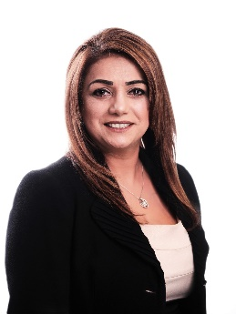
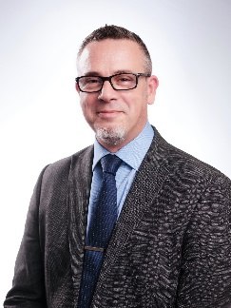
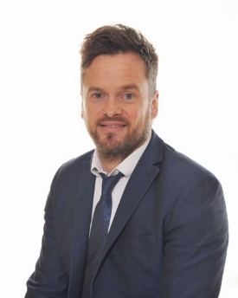
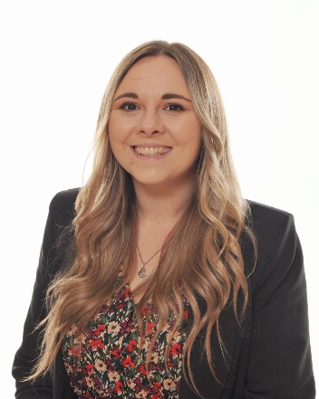
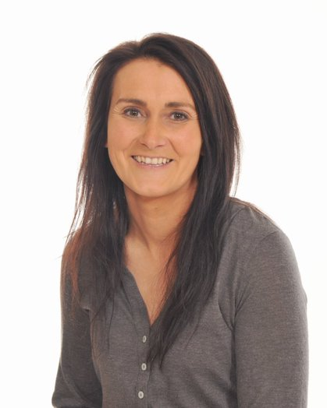
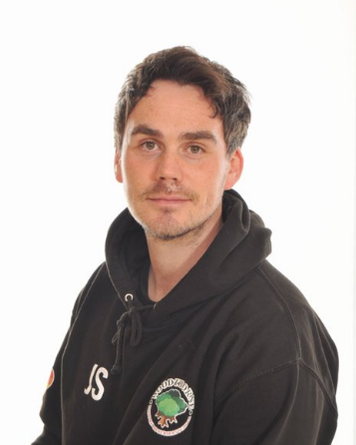
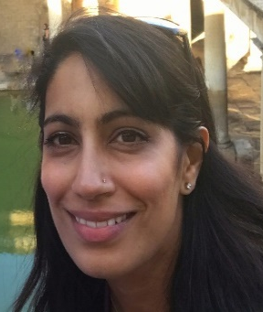
School Leadership Team
Mrs Cheema OBE
CEO
Mr Asbury
Executive Headteacher of Educational Standards
Miss Kohli
Executive Headteacher of Perry Hall Teaching School
Mr Hinkley
Head Teacher
Mrs Gibson
Chair of Governors
Mrs Jones
Assistant Head KS2 Phase Lead
Mr Johnston
Curriculum Lead
Mrs Hodgkiss
EYFS and KS1 Phase Lead
Mr Stack
SENCO

Slide 4
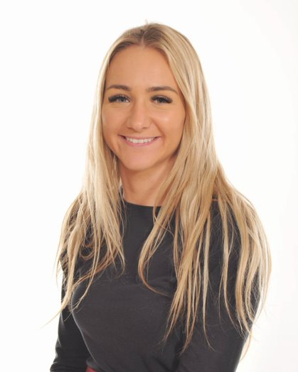
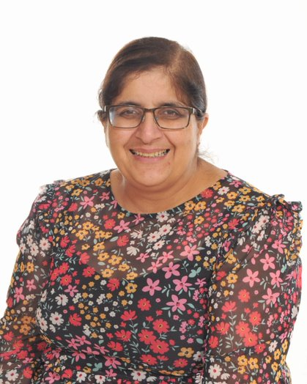
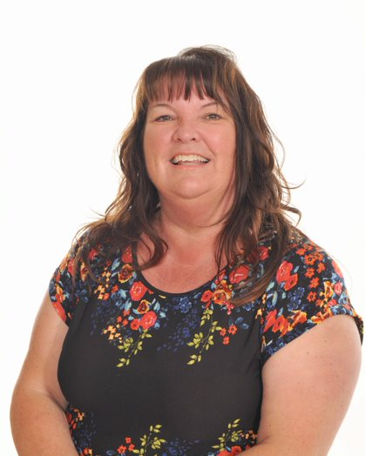
Reception Team
Mrs Hodgkiss
Class Teacher
EYFS & KS1 Lead
Miss Taylor
Class Teacher
Mrs Gakhal
HLTA
Mrs Elcock
Teaching Assistant

Slide 5
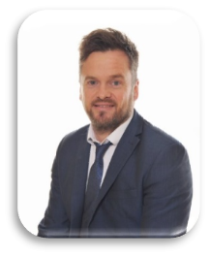
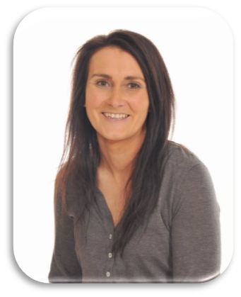
Inclusion Team
Mr Stack
SENCO
Mrs Pocock
Family support worker
Mr Hinkley
Head Teacher
Mrs Jones
Assistant Head
KS2 Phase Lead
Special Educational Needs policy and SEN Information Report can be found on the school website
https://woodthorneprimary.com/
The school follows the Local Authority recommend guidelines.

Slide 6
Inclusion Team
Mr Stack
SENCO
Mrs Pocock
Family support worker
Mr Hinkley
Head Teacher
Mrs Jones
Assistant Head
KS2 Phase Lead
Special Educational Needs policy and SEN Information Report can be found on the school website
https://woodthorneprimary.com/
The school follows the Local Authority recommend guidelines.

Slide 7
Safeguarding Team
At Woodthorne Primary School we are committed to the highest standard in protecting and safeguarding the children entrusted to our care at all times.
Mr Hinkley
Head Teacher
Mrs Jones
Assistant Head ​
KS2 leader
Mr Johnston
Curriculum Lead
Mrs Pocock
Family support
worker
Our Trust Safeguarding Policy can be found on the school website :
https:/woodthorneprimary.com/
If you have any concerns about the welfare of a child please come and talk to us
.

Slide 8
Safeguarding Team
At Woodthorne Primary School we are committed to the highest standard in protecting and safeguarding the children entrusted to our care at all times.
Mr Hinkley
Head Teacher
Mrs Jones
Assistant Head ​
KS2 leader
Mr Johnston
Curriculum Lead
Mrs Pocock
Family support
worker
Our Trust Safeguarding Policy can be found on the school website :
https:/woodthorneprimary.com/
If you have any concerns about the welfare of a child please come and talk to us
.

Slide 9
Our Core Values

Slide 10
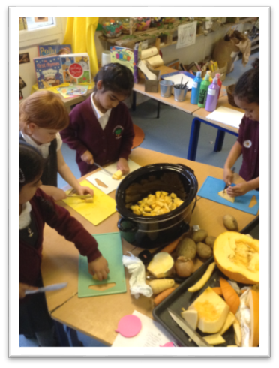
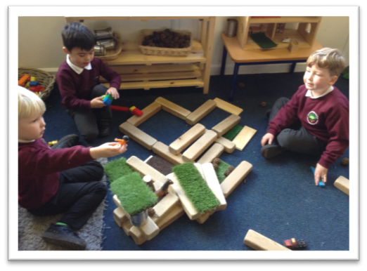
Our Early Years Ethos
Within Woodthorne EYFS, the children’s interests and choices are at the centre of our teaching and learning. This encompasses all opportunities including play, adult led group work, experiences and interactions. We believe that through modelling, encouraging, observing, listening supporting and caring for every child, we will inspire a love of learning which will last a lifetime.

Slide 11
What is the Early Years Foundation Stage?
The Foundation Stage covers seven areas of learning
– all areas of learning and development are important and inter-connected.
Personal, Social and Emotional Development
Self-regulation
Managing self
Building relationships
Communication and Language
Listening, attention and understanding
Speaking
Physical Development
Gross motor skills
Fine motor skills
Prime Areas
These three areas are particularly crucial for igniting children’s curiosity and enthusiasm for learning, and for building their capacity to learn, form relationships and thrive.
They lay the foundations for children's success in all other areas of learning and of life.

Slide 12
What is the Early Years Foundation Stage?
The Foundation Stage for children covers seven areas of learning
– all areas of learning and development are important and inter-connected.
Literacy
Comprehension
Word reading
Writing
Mathematics
Number
Numerical patterns
Knowledge of the World
Past and present
People, culture and communities
The natural world
Expressive Art and Design
Creating with materials
Being imaginative
Specific Areas
All children work towards 17 statements.

Slide 13
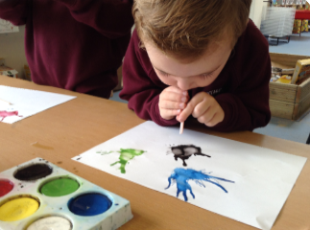
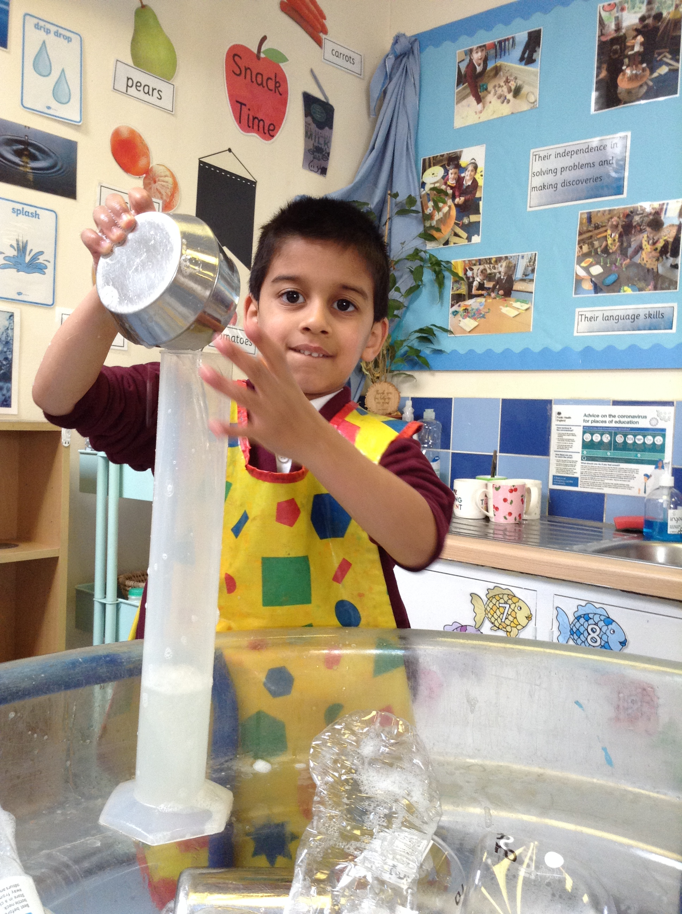
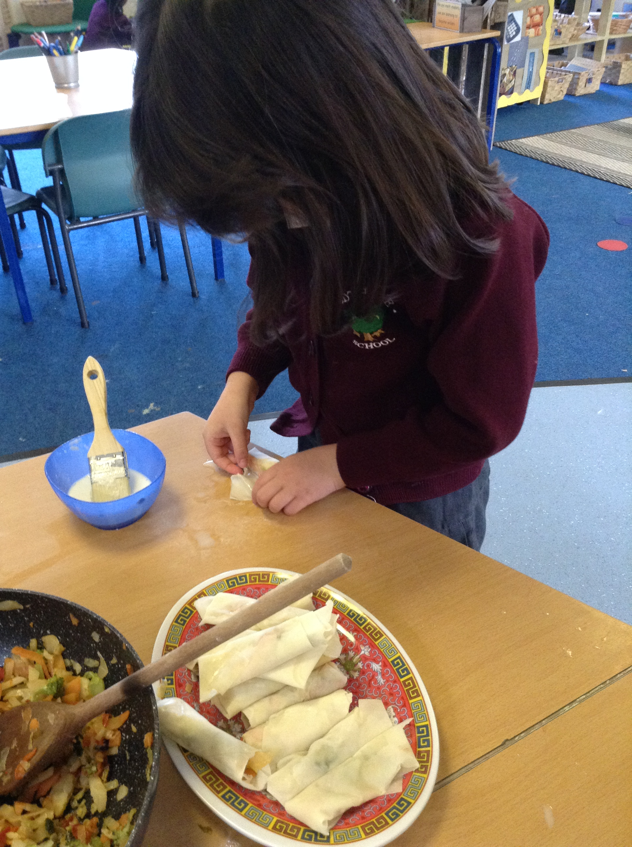
Playing and Exploring
(engagement)
Characteristics of Effective Teaching and Learning
The ways in which your child engages with other people and their environment
Active Learning
(motivation)
Creating and Thinking Critically
(Thinking)

Slide 14
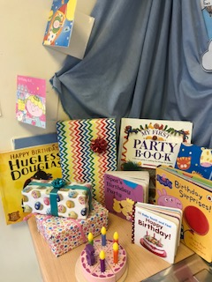
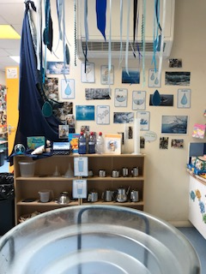
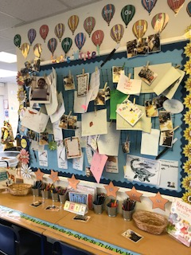
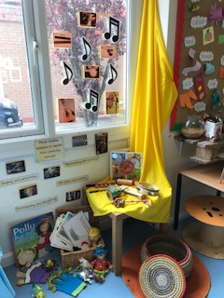
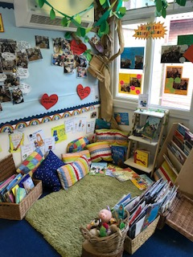
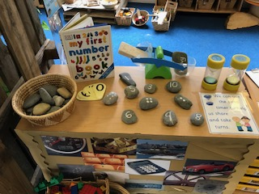
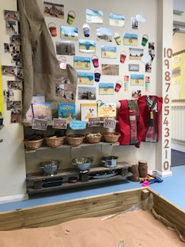
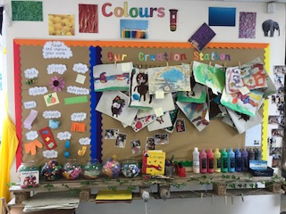
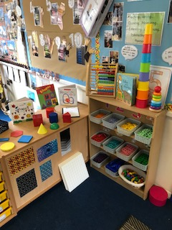
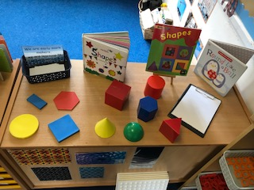
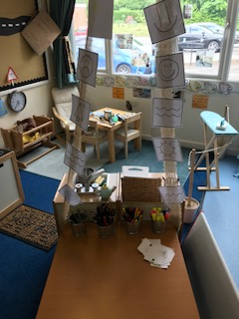
Inside Learning

Slide 15
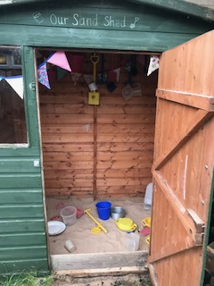
Outside Learning

Slide 16
Our School Day
Gates open at 8.30am
Doors open at 8.40am
Lunch is 11.45am – 12.45pm
Home time is 3.10pm
We ask that children arrive promptly and are picked up on time and you
ring school if there is anyone different collecting your child.

Slide 17
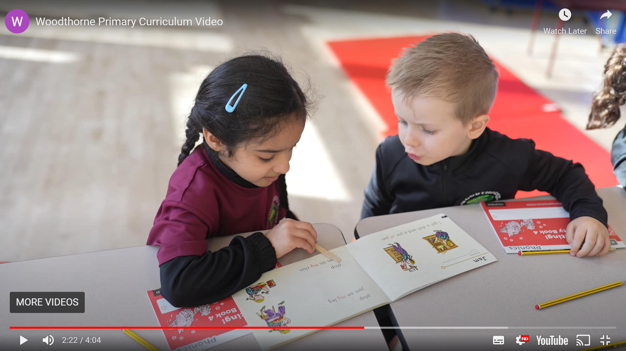
RWI Phonics
Read Write Inc (RWI) is a phonics complete literacy programme which helps all children learn to read fluently and at speed so they can focus on developing their skills in comprehension, vocabulary and spelling.
The programme is designed for children aged 4-7. However, at Woodthorne we begin the programme in Nursery and will continue teaching RWI to children beyond the age of 7 if they still need support in their reading.
RWI was developed by Ruth Miskin and more information on this can be found at https://ruthmiskin.com/en/find-out-more/parents/

Slide 18
How We Learn We learn through play
Adults spend time with children & make regular observations, these help us to plan.

Slide 19
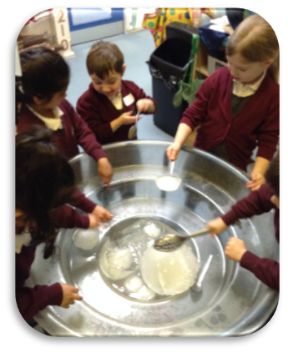
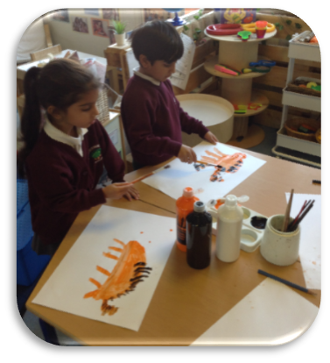
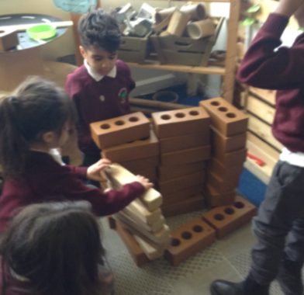
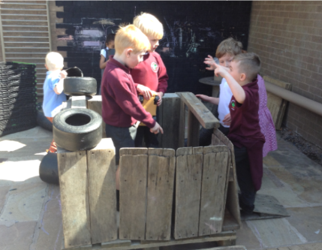
Daily Activities
Child initiated
learning
Adult led learning
Outdoor learning
Indoor
learning

Slide 20
Lunch & Snack Times
Free school meals
There is a charge for milk the term after the children’s 5th birthday
Free fruit for children in Early Years and Key Stage One
Nut free school (no Nutella or similar spreads please)
Water bottles

Slide 21
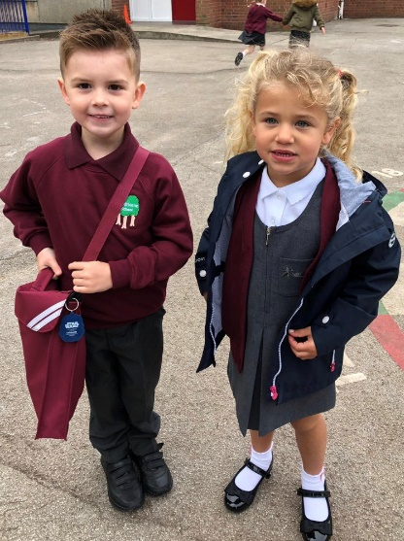
School Uniform
White or maroon shirt/polo shirt
Maroon jumper/cardigan
Grey trousers/skirt or pinafore
Burgundy summer dresses
Grey shorts
Black shoes
Woodthorne uniform can be bought from
Lads and Lasses or Trutex in Wolverhampton .

Slide 22
Active Wear Kit
On non - PE days - children should wear formal school uniform
On PE days - children should wear the ‘active uniform’ to school
We notify you of our PE days in September
Burgundy T-shirt
Black shorts/joggers
Black sweatshirt (without a hood)
Appropriate footwear (trainers)
You can purchase the required t-shirt and other optional items from Totally Uniform

Slide 23
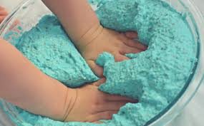
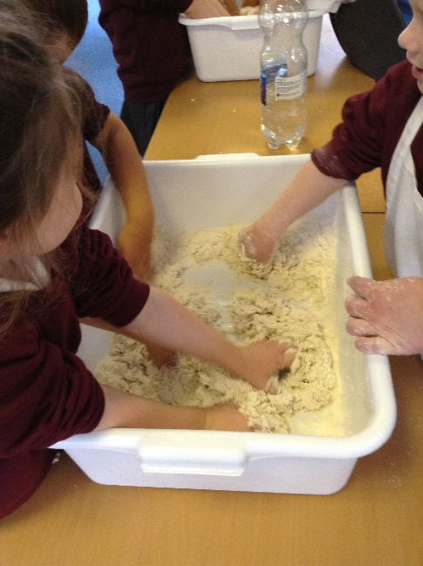
Messy Play And Outdoor Play
Sometimes we can get messy at school but this is because we are busy learning in so many different ways.
Messy play allows children to …
build, imagine, experience, investigate, explore, create, observe, predict and use their senses.

Slide 24
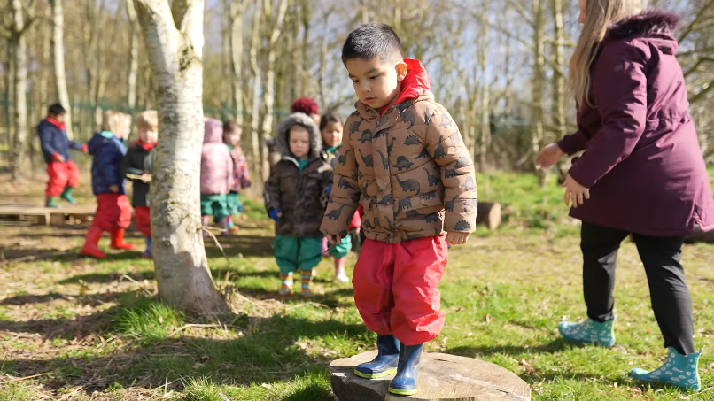
Forest Fridays
Forest Fridays are wonderful times spent exploring our beautiful woodland and grounds. The children adore them and they are an irreplaceable learning experience.
Please ensure your child has a named pair of wellies in school, the best Forest Fridays are the wet ones!

Slide 25
Reading And Home learning
RWI phonics
Children will bring a book of their choice home each week
We aim to change books on a Tuesday
Please fill in the reading diary

Slide 26
Preparing Your Children For School
Coats/zips
Shoes
Getting changed
Opening lunch & fruit
Using a knife and fork
Toileting and handwashing

Slide 27
Important Information
Please label everything (uniform, water bottles, bags, shoes, coats, wellies)
Please let us know about any illnesses or medical issues
Please talk to us – tell us if there are any changes to your personal details.
Keeping your children safe in school.
You will be given a log in for Teams in the first few weeks.
You will also be given a log in for Parentpay – we are a cash free school and all payments will be made over Parentpay.
Children can bring in a small bag each day or leave a bag at school with spare clothes in.

Slide 28
Stay and Play sessions
Wednesday 6th July - with parents/carers
children new to Woodthorne 10:00am – 11:15am
children who currently attend Woodthorne Nursery - 1:30 – 2:45pm
Tuesday 19th July – without parents/carers
children new to Woodthorne 10:00am – 11:15am
children who currently attend Wodthorne Nursery - 1:30 – 2:45pm

Slide 29
Reception Starting School Arrangements
Week 1 – week commencing 5th September 2022
Monday – INSET DAY
Tuesday – INSET DAY
Wednesday - Home visits
Thursday – Home Visits
Friday – Home visits
Week 2: - week commencing 12th September 2022
Monday – Home visits
Tuesday – 8:45am – 11:45am
Wednesday – 8:45am – 12:45pm (with lunch)
Thursday –8:45am – 2pm (with lunch)
Friday – 8:45am – 3:10pm (with lunch)
Week 3 : week commencing 19th September 2022
Full time - 8:45am – 3:10pm

Slide 30
Admission and Consent Forms
Completed in school :
All about me sheet
Emailed to be returned via email:
consent forms
photographs
walking to local area

Slide 31
Early Interventions
If you have any concerns about your child in any way please have a chat with us as soon as possible.

Slide 32
Breakfast Club And Afterschool Club
Breakfast club
Doors open at 7.30am
Afterschool club
From 3.00pm to 6.00pm
For more information please contact Ruth Edwards on 01902 921160
Places will need to be booked in advance.

Slide 33
Woodthorne PTA
If you would like more information please use the link below
https://www.woodthorneprimary.org/pta/
Or contact
secretary.woodthornepta@gmail.com

Slide 34
Any Questions?
If you have questions please get in touch with us
Ring: 01902 921160
E-mail: woodthorneprimaryschool@wolverhampton.gov.uk
This presentation will be uploaded on to our school website for your reference.

